Slide 1


Title: Integrating Clinical Data with Artificial Intelligence and Machine Learning for Effective Prediction of Dental Implant Success
Supervisor: Prof. Apostolos Dasilas
Venue: Gisma University of Applied Sciences Potsdam, Germany
Date: 08/10/2024
By Vishal Kumar

Slide 2
Background:
Traditional Clinical Approach
Clinician Experience
Limited predictive capability
Often overlook Key Predictors
Variability in predicting Implant success
Subjective Analysis
Studies Focus:
Objective: Develop a predictive model using AI and ML to enhance the accuracy of predicting dental implant success.
Focus Areas:
Biological Factors: Bone density, patient age, overall health.
Mechanical Factors: Implant size, placement, and load distribution.
Lifestyle factors: Smoking, diet, and oral hygiene.
Significance:
Revolutionize traditional clinical decision-making
Reduce failure rates, Ambiguity
Enable personalized treatments option based on patient Data
Why AI and ML?
Ability to analyze complex, non-linear relationship within large datasets, offer a comprehensive view of predictive factors.
Predictive Model
Comprehensive patient dataset
Objective Analysis
Data-driven Insights
(Lee et al., 2021)

Slide 3
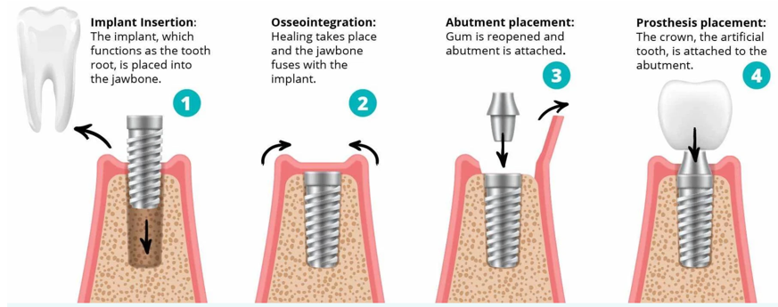
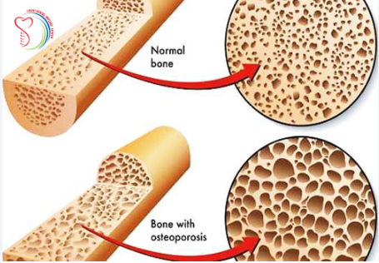
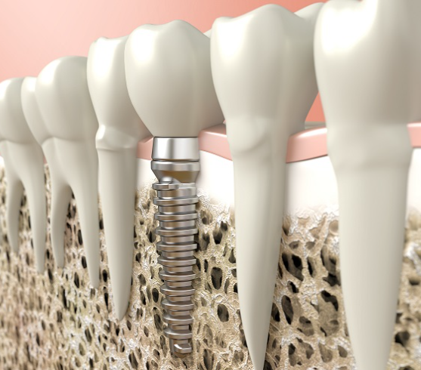
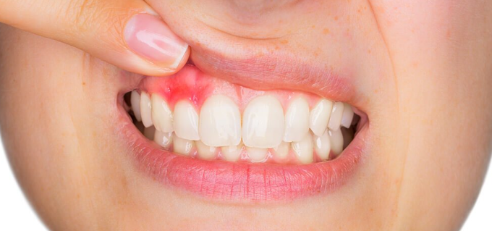
Research objectives:
1. Identify the key factors contributing to dental implant failure using advanced data analytics.
(Zajac et al. 2023)

Slide 4
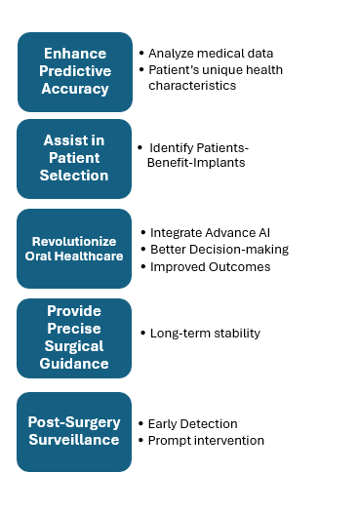
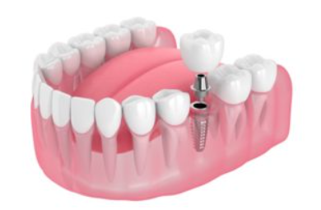
2. Develop a predictive model using AI to accurately forecast dental implant success rates for individual patients based on their medical data.
& Optimal Outcomes
Pre-surgery planning
Post-surgery outcomes
issues
and Manage potential problems
(Wang et al., 2022)

Slide 5
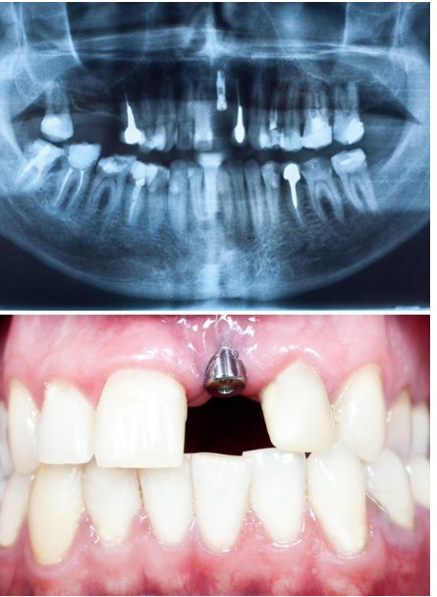
3. Utilized artificial intelligence techniques to integrate patient-specific variables into the predictive model, boosting the accuracy of dental image classification.
Model Development
ML utilization
Key factors considered
Continuous Learning and Validation
Comprehensive Assessment
Risk Profile Creation
Informed Decision-making
Overall Success Improvement
Patient Selection and Treatment planning
(Warmbrod et al., 2021)

Slide 6
Methodology:
Data Collection
Patient medical history
Data Preprocessing
Cleaned dataset
Model Selection
Random Forests
Dental Imaging (X-rays, MRIs)
Bone Density
Standardized formats
Image preparation (Resizing, enhancing)
Decision Trees
F1-score
Train/Test split
SVM
Model Training
Cross-Validation
Hyperparameter tuning
Model Evaluation
Accuracy
Precision
Recall
Google Colab
Python (scikit-learn)
Tools
Ethical considerations
Research design- a retrospective analysis
Secondary data
(Ehsanier et al., 2022)

Slide 7
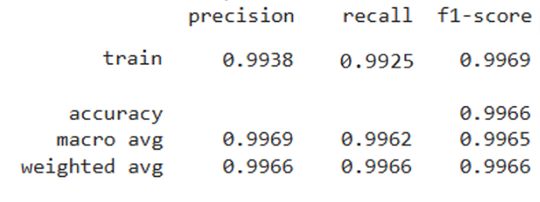
Main results and conclusion:
Model Performance:
Random Forest: Achieved the highest accuracy (~99%), demonstrating strong predictive capability.
Neural Networks: Showed potential but required significant computational resources.
Feature Importance: Bone density, implant depth, and patient health (Top).
Implications:
AI models can accurately predict outcomes, improving clinical decision-making.
Potential to guide personalized treatment plans and enhance patient outcomes.
Call to Action:
Encourage adoption of AI-driven tools in clinical settings to enhance patient care.
Advocate for ongoing research to refine these models and expand their use across various medical disciplines.
AI and ML significantly improve dental implant success prediction over traditional methods.
The study highlights the feasibility of integrating advanced analytics into clinical practice.
Conclusion:

Slide 8
Novelty and Contribution:
What is New?
Integrate multi-dimensional dataset
Applied Multiple AI and ML algorithms
Contribution:
AI-Based data-driven tool (personalized treatment→ patient-specific risk profile)
Potential modal adaptability to other area of dental practice
(Smith & Jones, 2023)

Slide 9
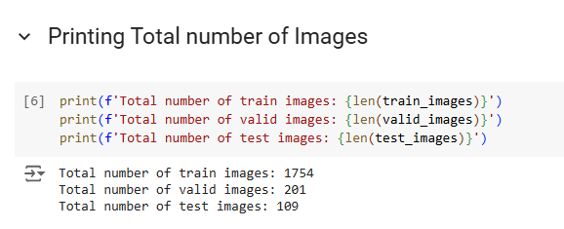
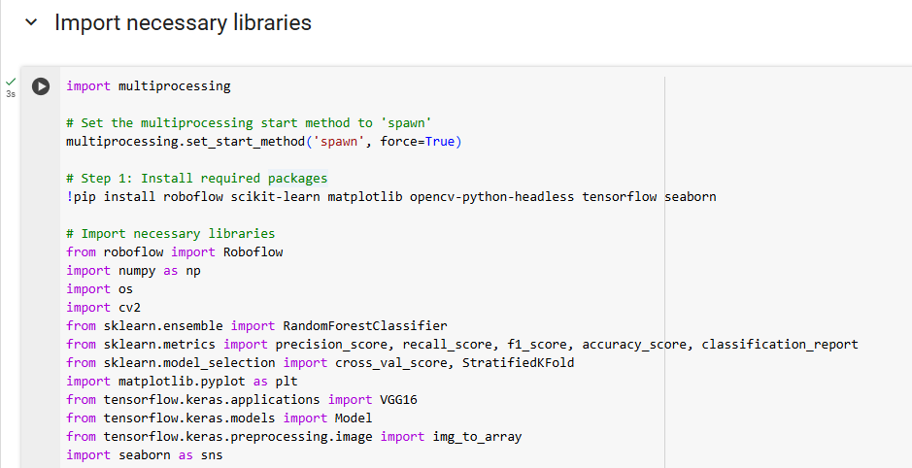
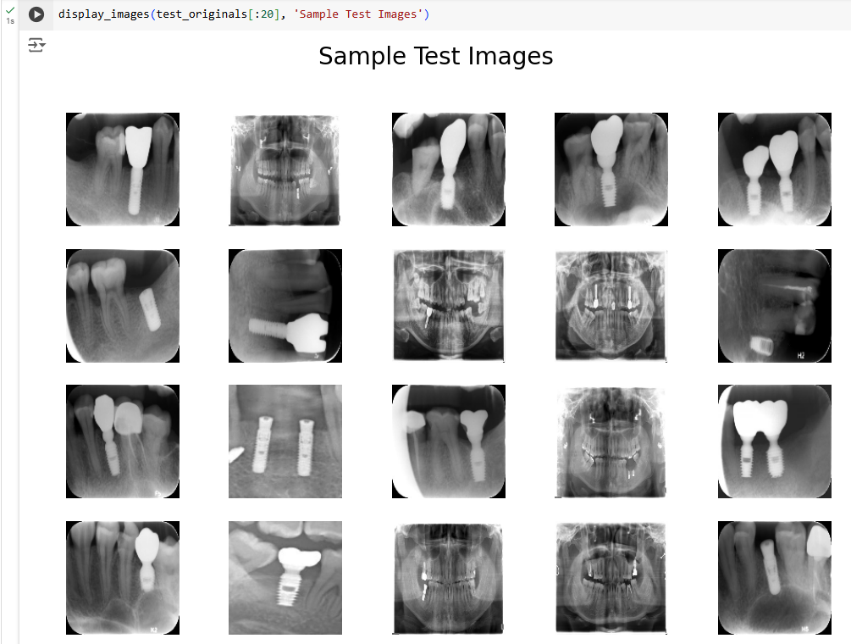
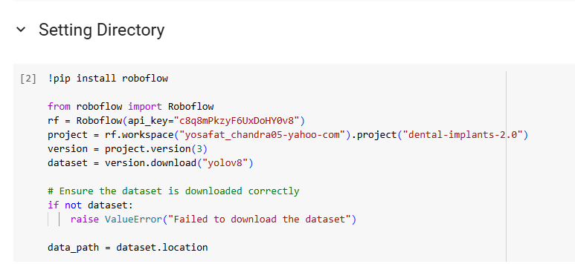
Output:
Sourced from Google Colab

Slide 10
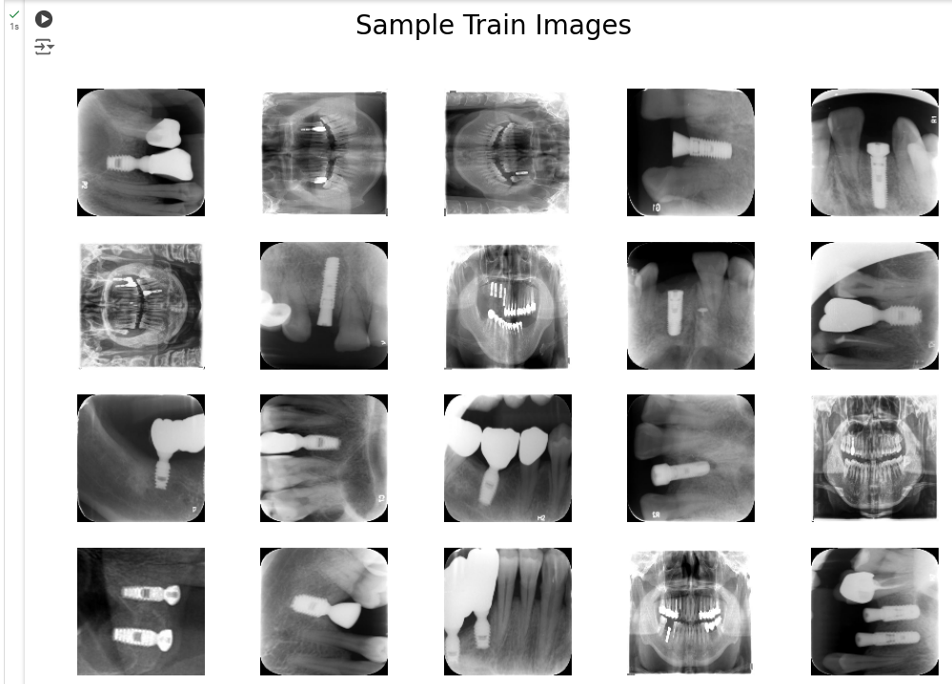
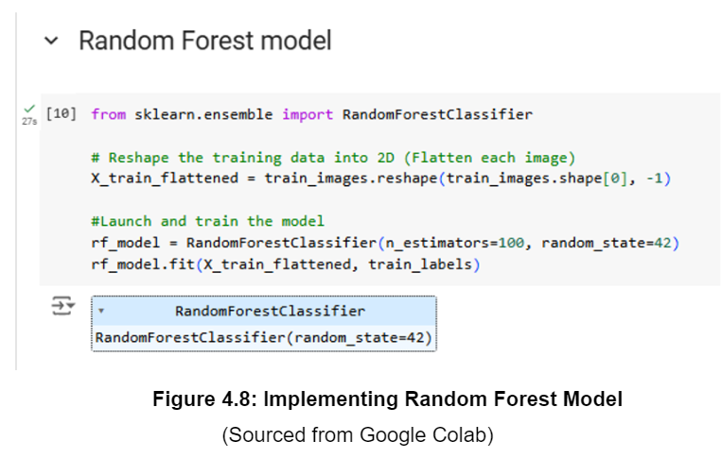
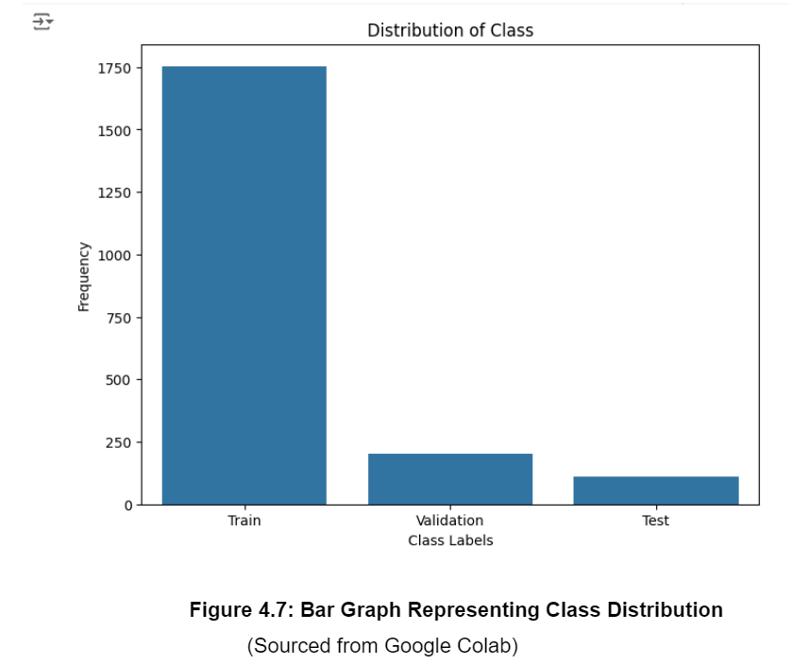
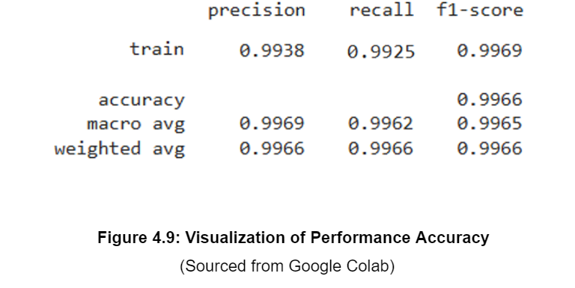

Slide 11
Limitations, Future Directions and Recommendations:
Limitations:
Challenges with data quality and completeness.
Need for further validation across diverse clinical environments.
Future Directions:
Incorporate real-time data from wearables and genetic profiles.
Develop user-friendly interfaces to encourage clinical adoption.
Recommendations:
For Dental Professionals:
Begin integrating AI tools into practice to leverage predictive analytics for better outcomes.
For Researchers:
Expand research to include larger, more diverse datasets and explore additional predictive variables.
For Policy Makers:
Develop guidelines for ethical AI use in healthcare, ensuring patient safety and data security.
(Sekhar et al., 2020)

Slide 12
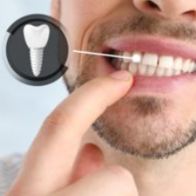
Application Clinical Impact:
Early risk detection
Electronic health records(EHR) Integration
Personalized treatment planning

Slide 13
References:
Lee, C.H., Choi, M.J., & Wang, Y.F. (2023). Contemporary Role and Applications of Artificial Intelligence in Dentistry. National Library of Medicine, Available at: https://www.ncbi.nlm.nih.gov/pmc/articles/PMC10630586/
Zajac, M., Yu, K., and F.C. Setzer, S. (2023). Comparison of perioperative and long-term outcomes following PEEK and Autologous Cranioplasty: A Single Institution experience and Review of the literature. National Library of Medicine, 93(1), 19–26.
Wang, Y., Chen, X., & Zhao, H. (2022). The Application of artificial intelligence in restorative Dentistry: A narrative review of current research: Enhancing aesthetic outcomes in restorative dentistry with AI. ScienceDirect, 36(10), Available at: https://www.sciencedirect.com/science/article/pii/S1013905224001044#s0080
Smith, J., Brown, A., and Zhang, H. (2022). Impact of Machine Learning in Predictive Dentistry. Journal of Dental Research, 98(4), 200–210.

Slide 14


